Slide 1
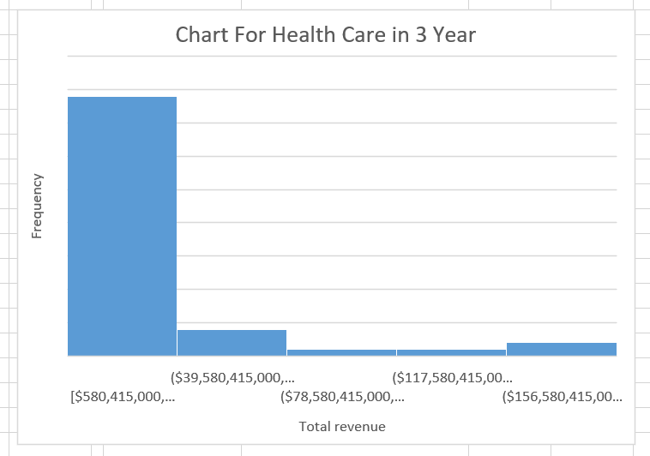
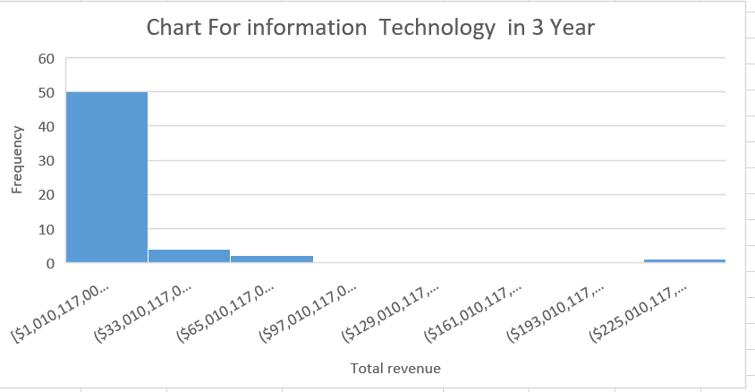
Does The Health Care Sector have similar expenditure level for Information Technology Sector in Year 3?
Here are the histograms for the expenses for Healthcare and Information Technology sector companies reported for all companies in Year 3.
Both distributions are right-skewed or positively skewed .That means, the mean for each is higher than the median
The mean for healthcare is about $24Billion. and for IT is $16 Billion. The median for healthcare ($9 Billion) and the median for IT is ($5 Billion). The standard deviation for healthcare is also slightly more ($40 billion) and ($35 billion) for IT companies. However, the Range IT is 232 billion and the Healthcare is 178 billion. Finally about Maximum IT is 233 billion and Minimum is 1 billion. The Healthcare Maximum is 179 billion and Minimum is 580 million.

